Slide 1
Language and Word problems
Part 2 Session 4

Slide 2
Syntax
Prepositions
‘divide 25 by 10’ and ‘divide 25 into 10’
‘reduce this price by £20’ and ‘reduce this price to £20’
Ambiguities
What is 10 divided into 5?’
(2 or 0.5?)
How much is 5 more than 3?’
(2 or 8?).

Slide 3
Abstract and natural language
58 – 13 = 45
Fifty-eight subtract thirteen equals forty five
As a word problem?
There were 58 people on the bus and 13 got off. How many were left on the bus?
If there are 58 people on the bus and 13 get off then there will be 45 people left.
Multiple options

Slide 4
Miscues in word problems
Sam has 18 computer games that is 5 more than he had last week.
How many games did he have last week?

Slide 5
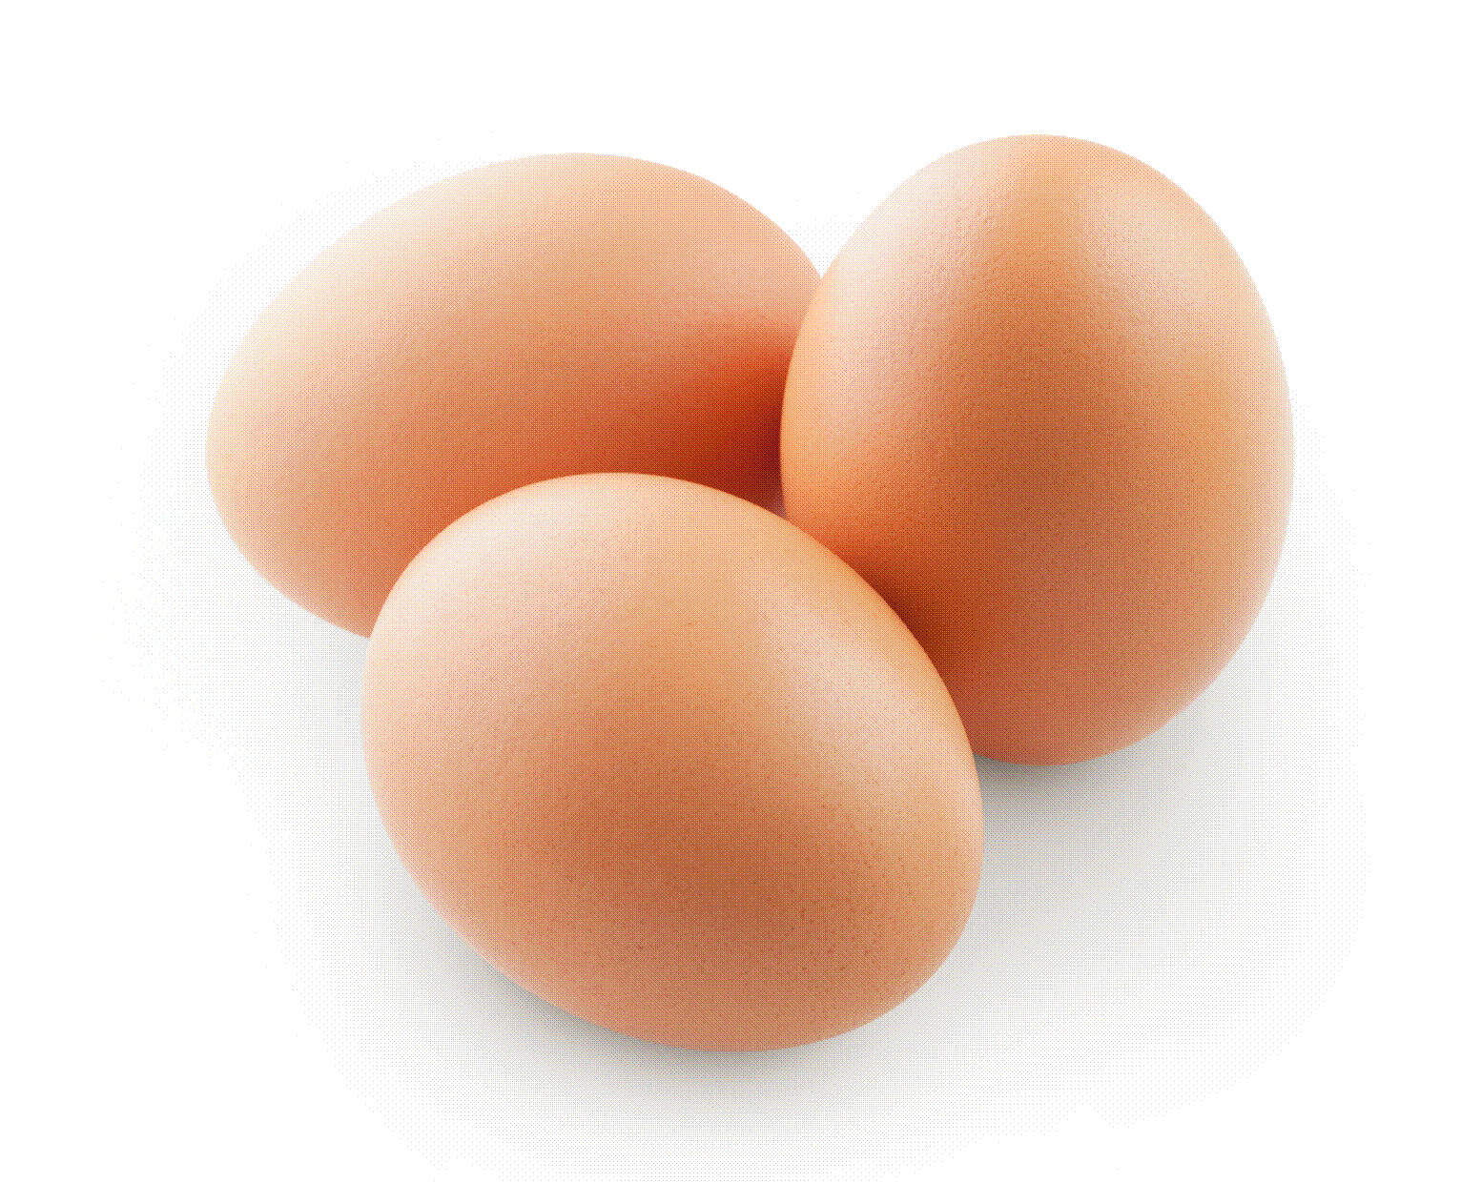
End of primary test question
In March, Ken collects 2, 3 or 4 eggs each day. In the first 20 days he collects 57 eggs.
What is the greatest number of eggs that he could collect in March?

Slide 6
Ken’s eggs
Who is this story about?
What is the story about?
Re phrase without the numbers- ‘Ken collects some eggs’

Slide 7
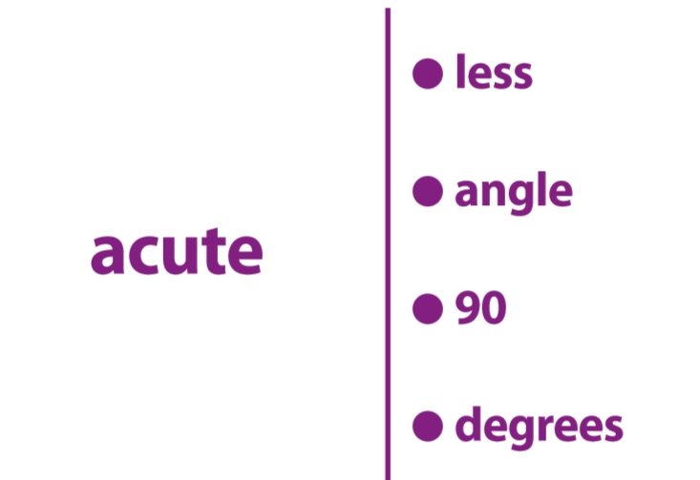
Fourbidden Game
Notes:
Suggestion 1 One pack of cards for each group, don’t let them see the cards before they start. In two teams take it in turns to describe the word on the
left hand side of the card, without using the word itself or any of the four forbidden words on the right hand side of the card. This may be competitive; against the clock (how many words in 1 min.); penalties for using any of forbidden words; or in any way you see fit. Some sort of barrier, hiding the cards from the other team, may need to be improvised. Suggestion 2 Opposite of Suggestion 1. Only the words on the right hand side of the card are allowed. Some scoring system, perhaps 10 points if just the first word on right used, 5 after second clue, 2 for third clue and 1 for all 4 clues.
Suggestion 3 Word on left hand side of card given and the team has to guess the four forbidden words. Suggestion 4 The word on the left has to be discovered but by drawing rather than speaking. Suggestion 5 Used as a basis for teachers/pupils to invent their own cards - there are many more that could be used. Numbers are without limit !

Slide 8
Can you guess the four words?

Slide 9
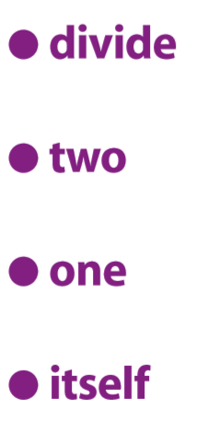
Can you guess the word?

Slide 10
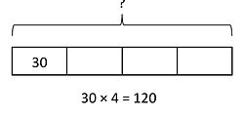
Dyslexia and Reading - Bar model

Slide 11
Bar Modelling
When solving word problems, it is often not the calculation that children can’t do – rather they are not sure which calculation they need to do.
(NCETM, 2013)

Slide 12
Variations of Bar Model
Part- Whole Model
Comparison Model
Before After Model

Slide 13
Aaron has three times as much money as Beth. Together, they have $120.
How much do they each have?

Slide 14
Aaron
Beth

Slide 15
Bar Model example
Zack spent 1/5 of his savings on a gift and ½ of the remainder on a book. The book cost $12.
How much were Zack’s savings?

Slide 16
Zack’s Savings
Gift |  |  | Book $6 | Book $6

Slide 17
Before and After Problem
Sam had 5 times as many marbles as Tom. If Sam gives 26 marbles to Tom, the two friends will have exactly the same amount.
How many marbles do they have altogether?

Slide 18
Before
Sam
Tom
After
Sam
Tom
Where are the 26 marbles? Can you see?

