Slide 1
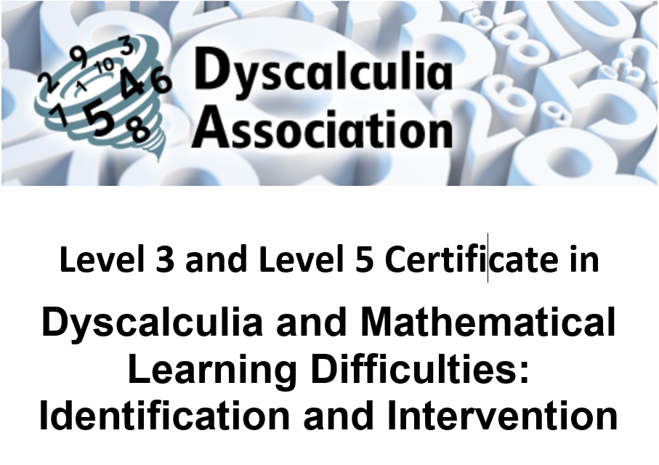



Slide 2
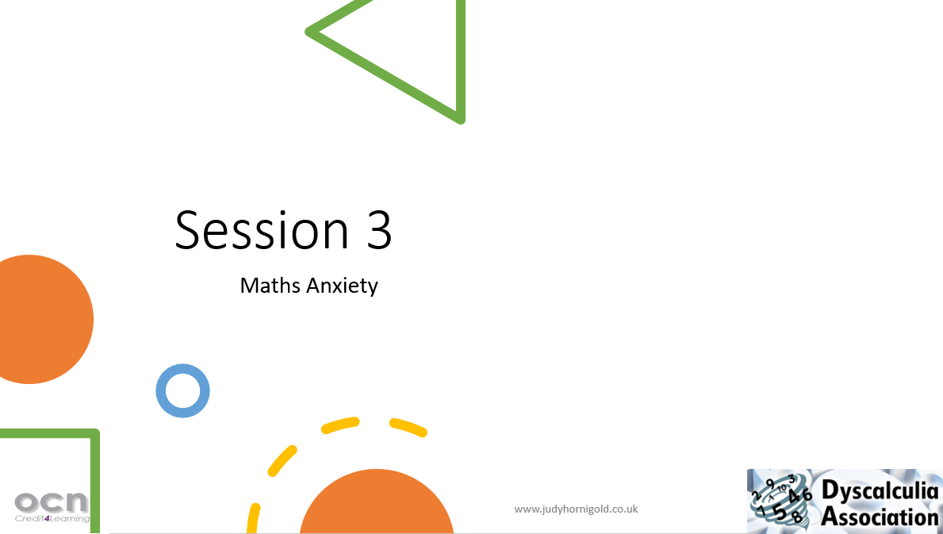

Slide 3
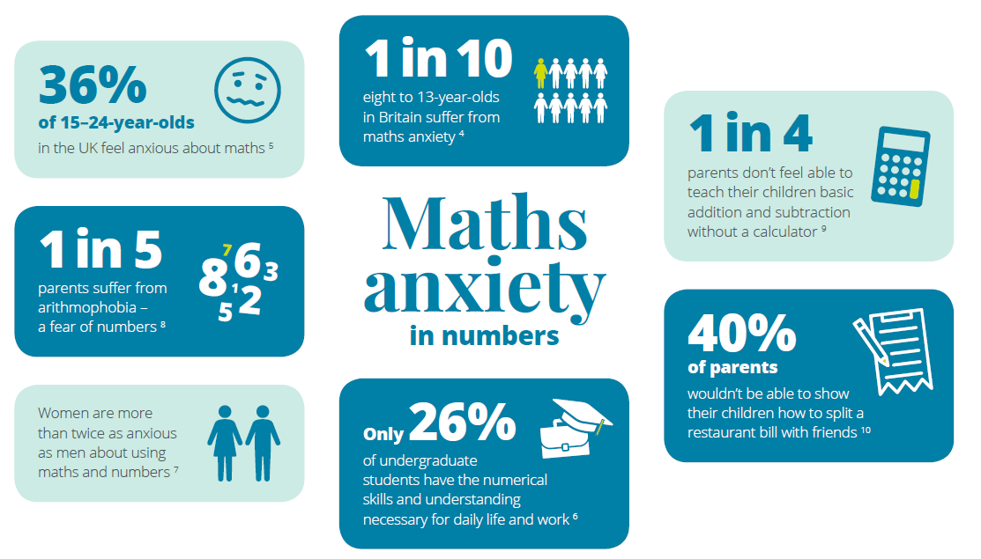

Slide 4
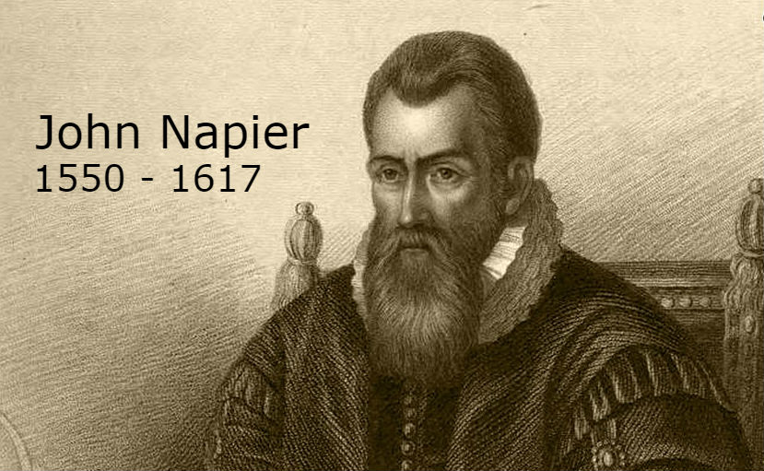
“Multiplication is vexation, division is bad. The rule of three doth puzzle me, and practice drives me mad.” 1570

Slide 5
Overview
What is maths anxiety?
How can we identify it?
How can we help children to overcome their anxiety?

Slide 6
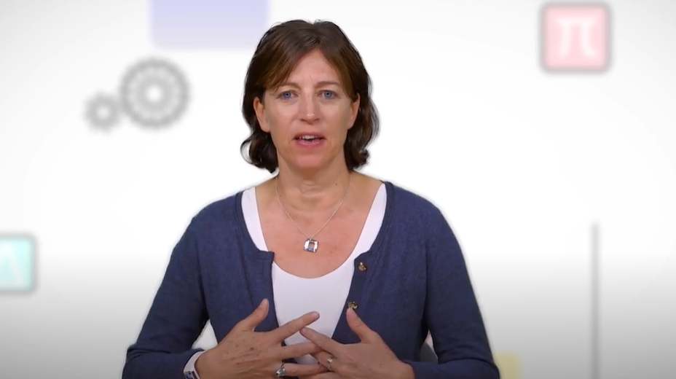
Jo Boaler- Everyone can do maths https://www.youtube.com/watch?v=3ZyVBwnScJw

Slide 7

What is Maths Anxiety?
This Photo by Unknown Author is licensed under CC BY

Slide 8
Maths Anxiety- Definitions
Maths anxiety has been defined as
‘the panic, helplessness, paralysis, and mental disorganization that arises among some people when they are required to solve a mathematical problem.’
Tobias and Weissbrod (1980)
Notes:
Brain not wired for abstract maths

Slide 9
Maths Anxiety- Definitions
Robinson and Simone (1976) defined math anxiety as
“feelings of tension and anxiety that interfere with the manipulation of numbers and the solving of problems in a wide variety of ordinary life and academic situations.”
Notes:
Brain not wired for abstract maths

Slide 10

Why do so many people get maths anxiety?
https://www.youtube.com/watch?v=7snnRaC4t5c&feature=youtu.be

Slide 11
Maths Anxiety can be related to
Life Experiences
attitudes of parents, teachers or other people in the learning environment
some specific incident in a student’s maths history which was frightening or embarrassing
poor self-concept caused by past history of failure
Notes:
Learner’s attitudes
Lack of belief in ability
Lack of faith in intuition
Negative beliefs
Giving up before really trying
‘Dropped stitch’ thinking
Depression
Fear of failure

Slide 12
Maths Anxiety can be related to
Teaching Techniques
Anxiety can be caused by teaching techniques which emphasize:
  timed activities
  the right answer
  speed in getting the answer
  competition among students
  working in isolation
  memorization rather than understanding

Slide 13
Have you ever experienced Maths Anxiety?
What situations make you feel anxious?
How do we know when this is becoming a real problem?

Slide 14
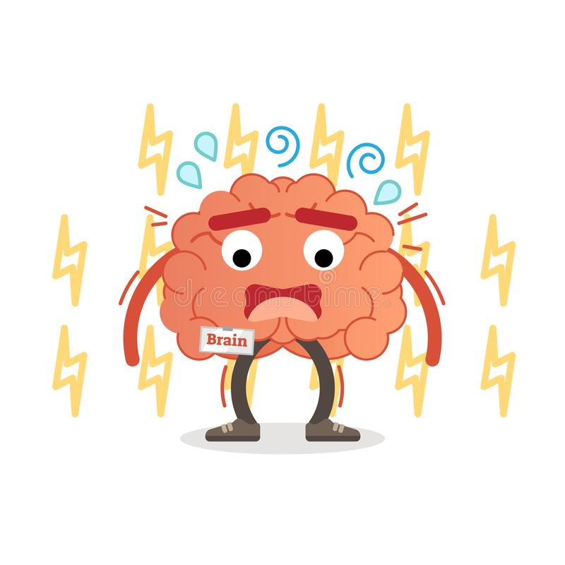
Symptoms of maths anxiety
Sweating
Rapid heart rate
Mental confusion
Headache
Biting nails
Tummyache

Slide 15
Maths Anxious or just ‘lazy’?
Not starting work
Taking too much time
Focus only on easier questions
Default response ‘I don’t know’
Not knowing where to start
Blurting out any number
Not showing working out
Not finishing work

Slide 16
Maths Anxiety Questionnaire by Ellen Freedman
1 = Disagree, 5 = Agree
Do you:
Cringe when you have to go to math class? 1 2 3 4 5
Get uneasy about going to the board in a math class? 1 2 3 4 5
Understand math now, but worry that it will get
really difficult? 1 2 3 4 5
Tend to zone out in math class? 1 2 3 4 5
Fear math tests more than any other kind? 1 2 3 4 5

Slide 17
Maths Anxiety Questionnaire
Know how to study for math tests? 1 2 3 4 5
Understand math in class, but seem to forget
it all when you get home? 1 2 3 4 5
Are you:
Afraid to ask questions in math class? 1 2 3 4 5
Worried about being called on in math class? 1 2 3 4 5
Afraid you won’t be able to keep up with the rest of the
class? 1 2 3 4 5

Slide 18
How high is your maths anxiety?
Add up the numbers and check your students’ scores.
10-19 — You probably love math
20-29 — You may have math anxiety
30-39 — Math clearly makes you uneasy
40-50 — You have math anxiety

Slide 19
Feeling that you will always be bad at Maths
Is there a Maths gene?
Are you born bad at Maths?
Will you ever be able to learn Maths?

Slide 20
Severe emotional reaction to maths
Anxious doing maths in front of others
Anxious when being timed
Anxious when someone else is doing maths

Slide 21
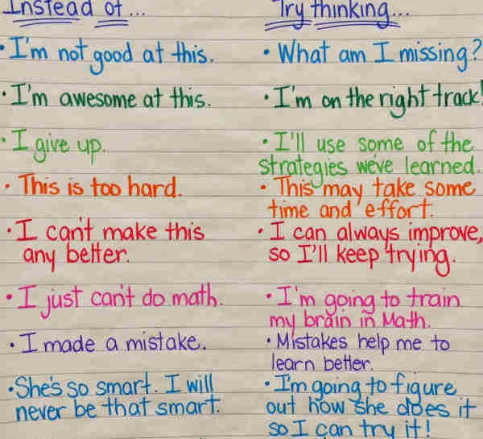
Negative self talk

Slide 22
Cycle of failure
Negative experience of maths
Maths avoidance
Poor preparation
Poor performance

Slide 23
Fear of being wrong
Are all mistakes bad?
What is a good mistake?
Why do we make mistakes ?

Slide 24
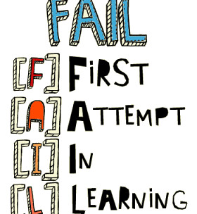
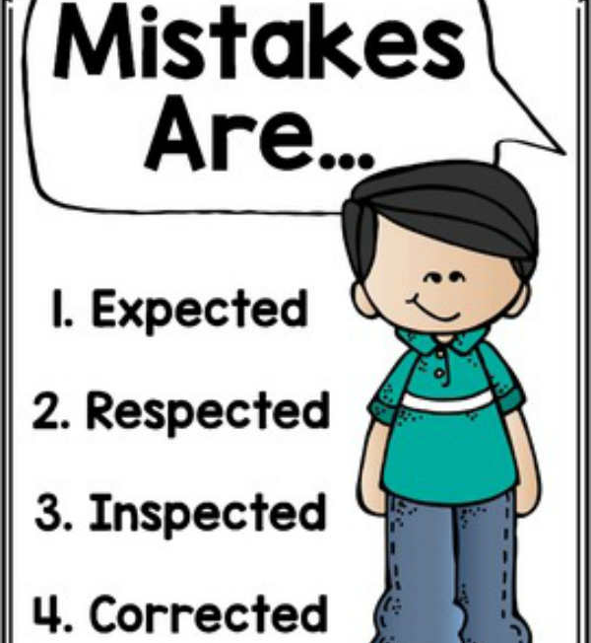

Slide 25
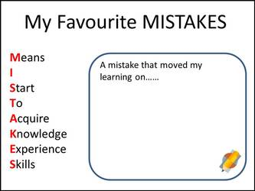

Slide 26
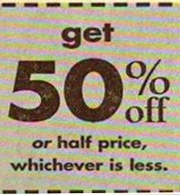


Slide 27

Parental Influences
Is Maths Anxiety hereditary?
This Photo by Unknown Author is licensed under CC BY-NC-ND

Slide 28
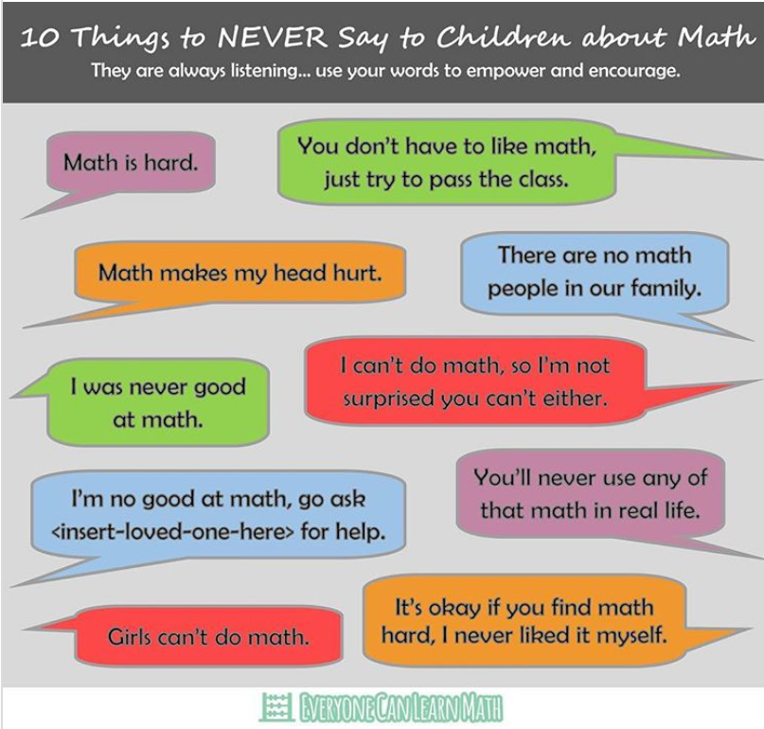
Things to never say to children

Slide 29

Teaching Methods

Slide 30
Maths lessons
“Evidence suggests that math anxiety results more from the way the subject is presented than from the subject itself.”
J. Greenwood (1984)
Notes:
Few maths classes are structured in such a way as to relieve anxiety. There will always be time limits, right answers, and competition. Reducing maths anxiety will not make students ‘smarter’ in maths. However, it could allow a students to reach their full potential

Slide 31

Climbing a broken ladder

Slide 32

Affective domain
“A teacher must do more than just prepare great lessons. Success for many children is related to how we make them feel in class.”
Fiore, 1999

Slide 33
Cognitive v Affective Domains
Cognitive domain
Mental Activity
Creating
Evaluating
Analysing
Applying
Understanding
Remembering
Affective domain
Character and Conscience
Characterising
Organising
Valuing
Responding
Receiving

Slide 34
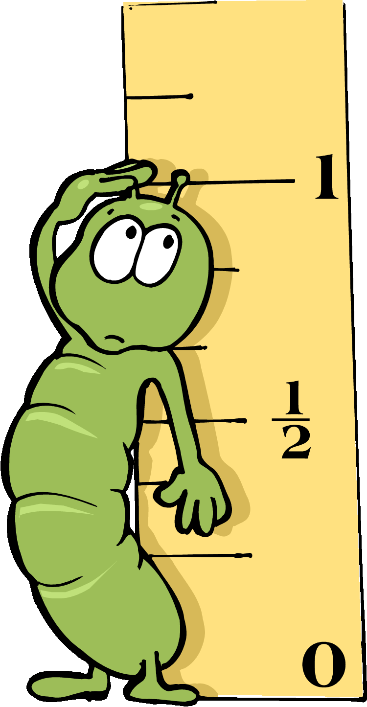

Learning Styles
Notes:
Bath et al (1986) grasshopper and inchworm
Sharma (1989) qualitative and quantitative
Modern= sequential and holistic

Slide 35
Overcoming maths anxiety
Building Maths Resilience
Being able to engage with maths with reduced anxiety
The growth zone model

Slide 36
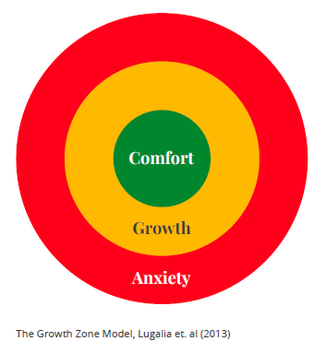
Growth Zone Model
The comfort zone
familiar tasks independently,
building self-confidence
practice and automaticity
The growth zone
new learning happens
safe to make mistakes, get stuck, require support
activities may be challenging and tiring
The anxiety zone
Beyond learner’s reach for now
threat rather than challenge,
stress increases, cognition decreases, and little or no learning

Slide 37
Which zone are you in?
Identify where you are for this activity
Teachers can help you move from comfort to growth
Teachers can help support you if you are in the red zone

Slide 38
Techniques to overcome Maths anxiety
Writing down your worries- based on Emotion Regulation Theory (Klein and Boals 2001)
Reappraisal of anxiety- Beltzer, Nock, Peter and Jamieson (2014)
Deep breathing/Slow breathing
Imagining Safe place
Humour
David Sheffield , University of Derby

Slide 39
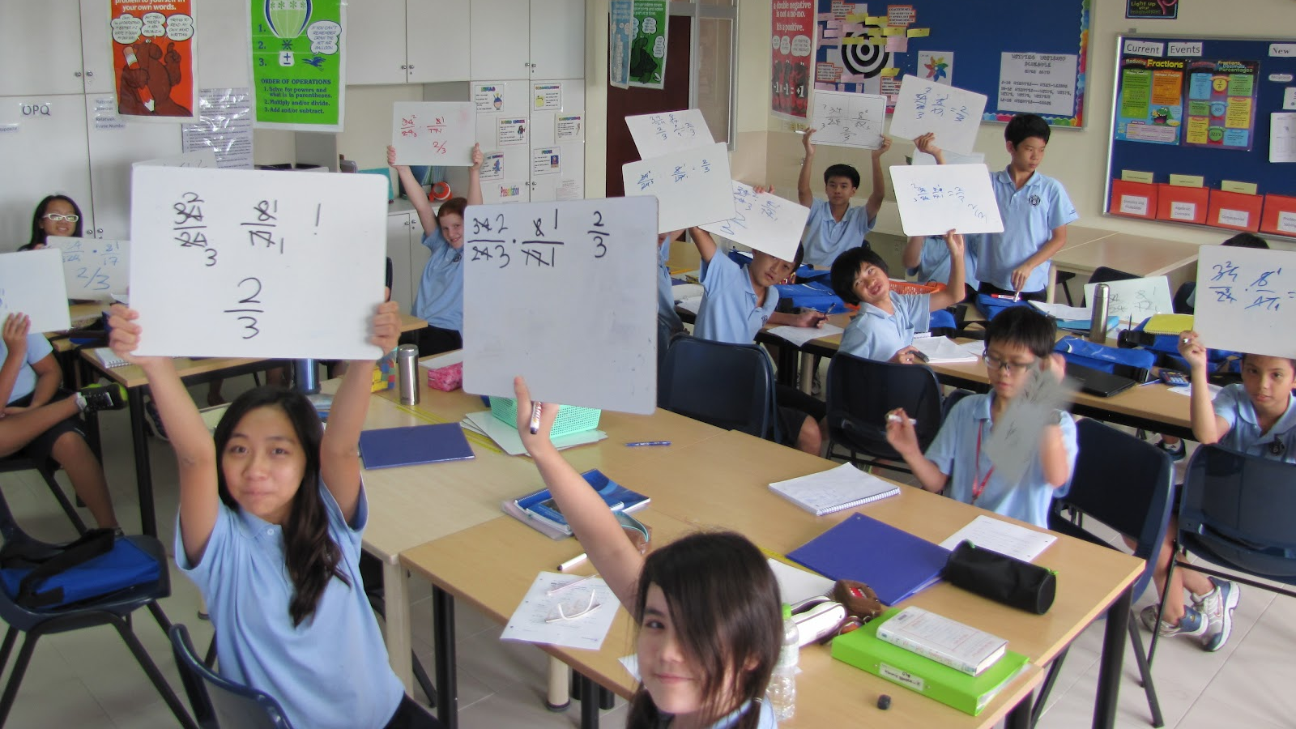
How to reduce anxiety in the maths classroom
This Photo by Unknown Author is licensed under CC BY-NC

Slide 40
How to reduce maths anxiety in the classroom
Low threshold High Ceiling tasks
Appropriate Scaffolding
Productive struggle
Mixed ability grouping
Read maths books- such as Bedtime Maths
Reappraise anxiety
Encourage understanding not memorization
Give time to answer questions
Mindset
Express yourself
Foster the idea that mistakes are good
Spend time developing number sense at an early age
Use concrete manipulatives in a way that develops understanding
Make maths fun

Slide 41
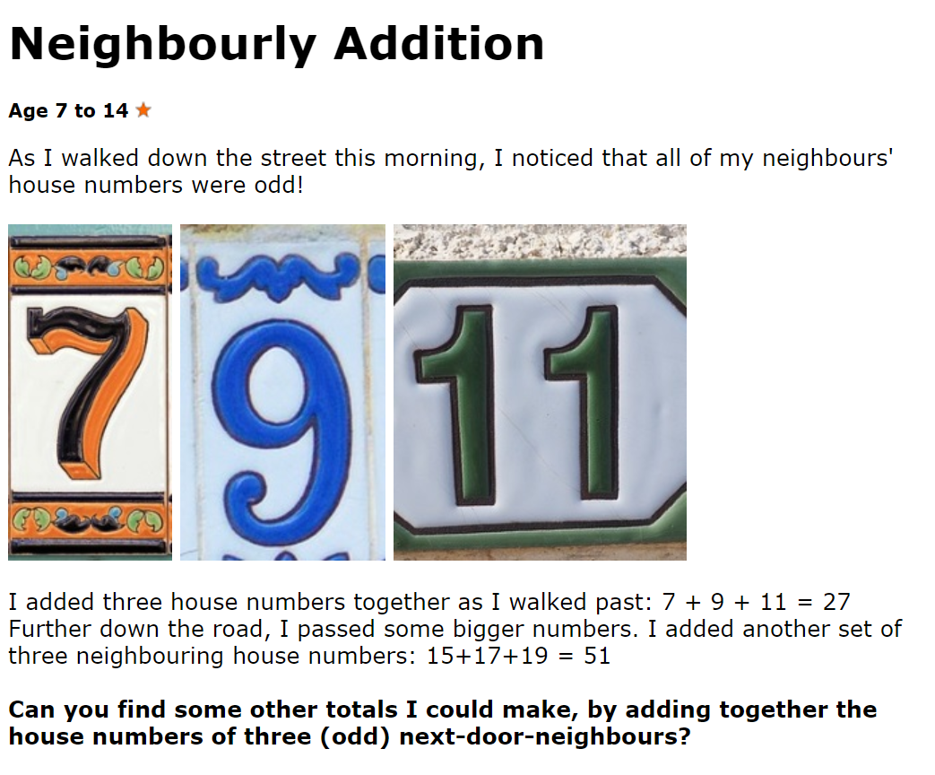
Low threshold High Ceiling tasks

Slide 42
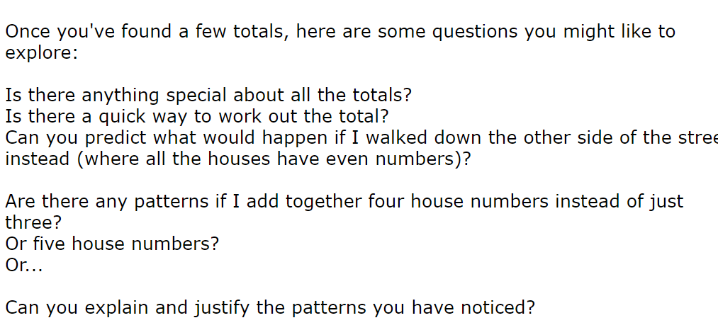

Slide 43
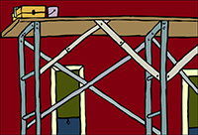

Scaffolding and Productive struggle

Slide 44
Mixed ability grouping

Slide 45
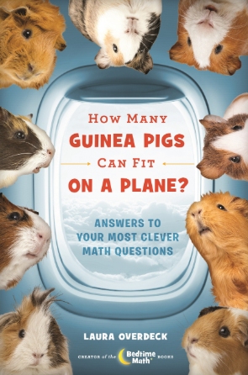

Bedtime Maths

Slide 46

Time

Slide 47
Carol Dweck: Mindset
Fixed mindset: Maths ability is a gift
Growth mindset: Maths ability grows with experience , persistence, learn from mistakes, determination to keep going, encouraged by other’s success
Mindset: The New Psychology of Success (2007)
Notes:
Carol Dweck has trained premier league footballers
If your mum says ‘I wasn’t any good at maths then the child’s marks will go down’
Fixed mindset comes from fixed praise
If a parent says you are clever, then the child will hear that , but this can backfire later if they struggle with something because they think that this means they are not clever
Better to say you have tried really hard. You have done really well
Experiment- half of a class were given one extra sentence in their feedback from teachers and the other half did not have that sentence.
The chidlren with the extra sentence did better when tested one year later
The sentence was I am giving you this feedback because I believe in you

Slide 48
Mindset and Maths
Lowest achieving children are those who use a memorization technique for maths
Highest achievers are those who look for connections and have big ideas
Notes:
Lowest achieving are actually doing the hardest maths

Slide 49
Statement | Strongly Agree | Agree | Disagree | Strongly Disagree
You are either good at Maths or you aren’t and you can’t change it.
You can only do well in Maths if you are clever.
Your memory affects how good you are in Maths.
Learning new mathematical skills does not mean you are changing your ability.
You can do a lot to change how clever you are.
You can do a lot to change how well you understand mathematics.
If you can answer a question quickly you are good at Maths.
How many answers you get right on a test shows how good you are at Maths.
Practice exercises are the best way to learn new mathematical skills.
Watching a teacher do examples is the best way to learn new mathematical skills.
Trying a problem you don’t know how to solve is the best way to learn new mathematical skills.
The set you are in tells you how good you are at Maths.
I prefer to work on questions that challenge me rather than questions that I find easy.
Notes:
Share with colleagues how they could use the questionnaire to identify growth mindset students. Base data, what does this look like at the end of the year.

Slide 50
Which Mindset do you model?
Promotes a Fixed Mind Set | Promotes a Growth Mind-Set
Praising students for being smart | Praising effort and strategies
Formative comments that emphasis achievement | Formative comments that emphasise effort and application
Praising students for achievements that come easily | Building robust self confidence
Spending time documenting intelligence and ability | Spending time developing intelligence and ability
Directing students to which tasks to complete | Giving students a strong voice in the learning process and a sense of purpose
Boosting self esteem | Providing constructive criticism
Place importance on grades / levels rather than learning | Place importance on learning rather than grades / levels

Slide 51
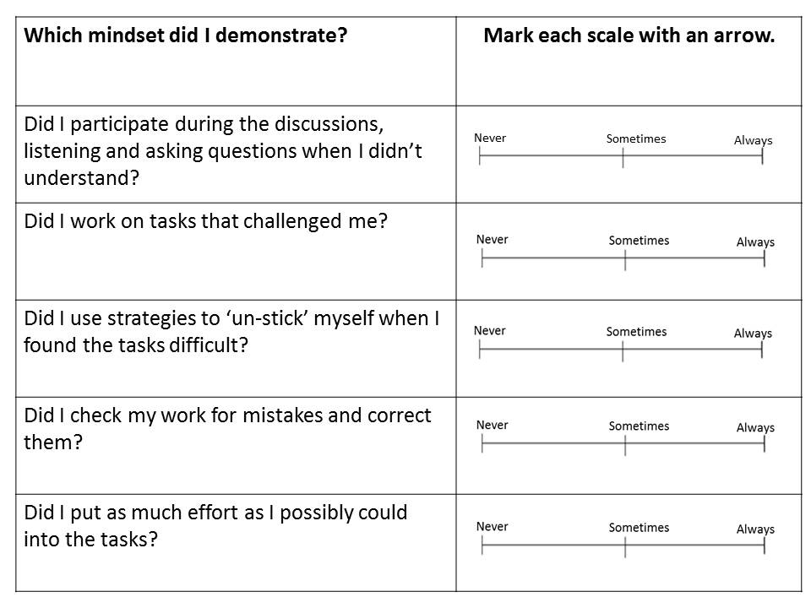

Slide 52

Mistakes
‘Every time a student makes a mistake in maths they grow a new synapse’
Carol Dweck
Notes:
No mistake – no growth

Slide 53


Slide 54
Number sense
What is number sense?
Consider the number 6

Slide 55
Activity
How would you calculate
31+29+30?
2000 x 0.25?
8+7+4+2+3+6?

Slide 56
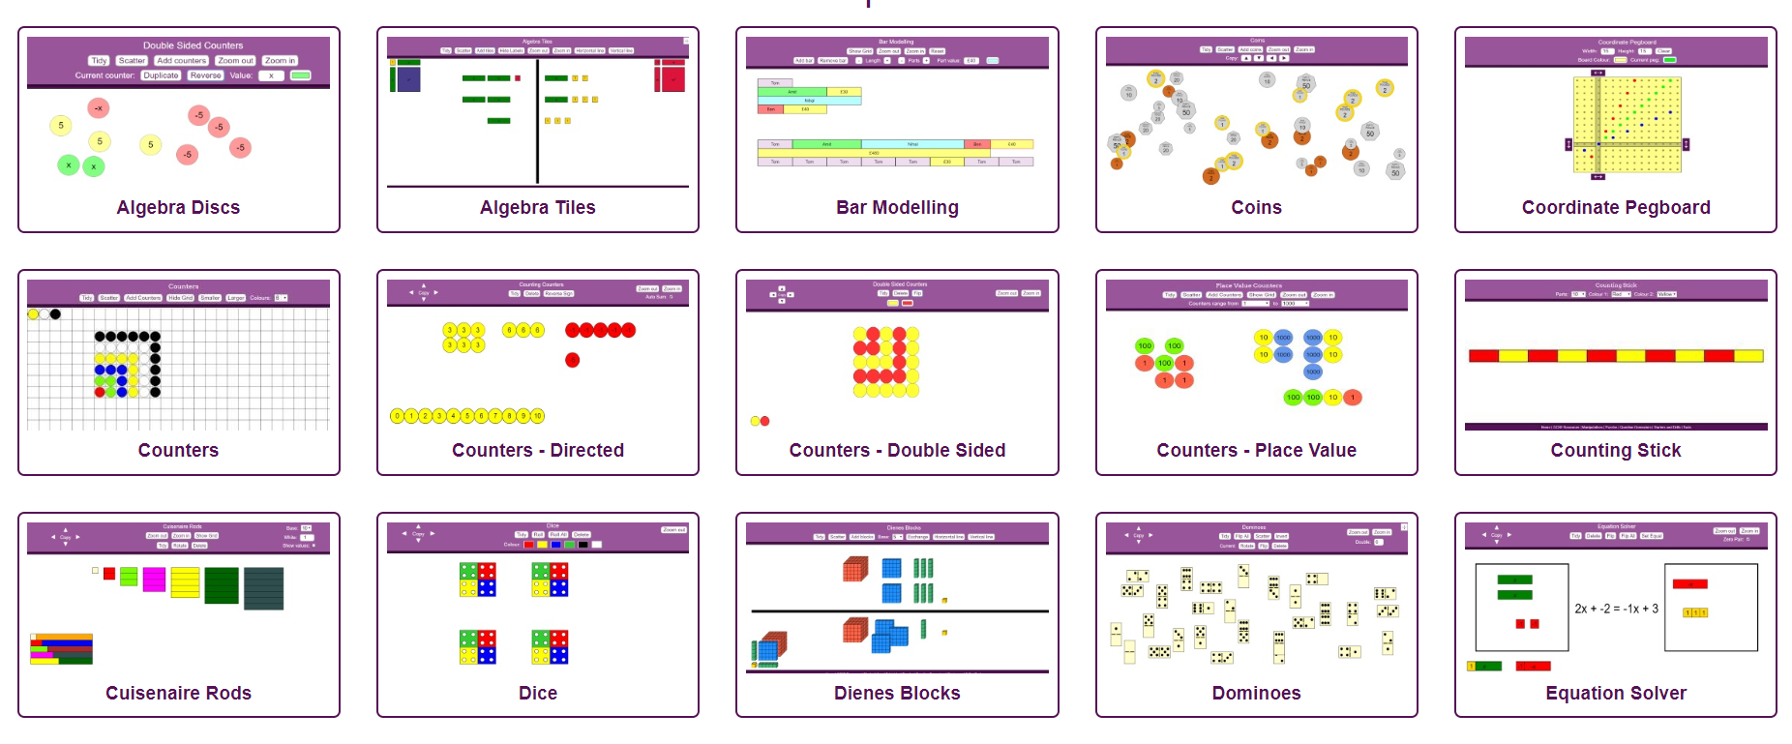
Manipulatives

Slide 57
National Curriculums
UK refers to ‘a sense of enjoyment and curiosity’
NZ refers to numbers that ‘amuse, delight, illuminate and excite’

Slide 58

The 3 C’s in Maths
Computation
Calculation
Counting
x
Curiosity
Creativity
Collaboration

Slide 59

Shape and Space
Climbing through a piece of paper
Take an A4 piece of paper. Cut it so that you can climb through the paper- keeping the paper in one piece.

Slide 60

