Slide 1
Dyscalculia Awareness Quiz True or False
Notes:
A PPT presentation for staff to raise awareness of dyslexia.
Hand out true/false paddles to show for each question or give questions on a grid for staff to discuss & answer true/false.

Slide 2
1.Dyscalculia isn’t as common as dyslexia.

Slide 3
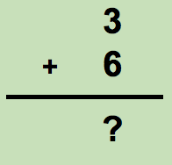
2.Dyscalculia is just dyslexia with numbers.

Slide 4
3.Dyscalculia can’t be diagnosed until you are 7 years old.

Slide 5
4.All children with dyscalculia have the same difficulties with Maths.

Slide 6
5.Dyscalculia is another name for maths anxiety.

Slide 7
6.Children with dyscalculia will never learn maths.

Slide 8
7.Dyscalculia is related to IQ.

Slide 9
8.Dyscalculia means having a poor memory for some information.
This Photo by Unknown Author is licensed under CC BY-SA

Slide 10
9.Dyscalculia is more common in girls than boys.

Slide 11
10.Dyscalculia can be cured.
This Photo by Unknown Author is licensed under CC BY-SA

Slide 12
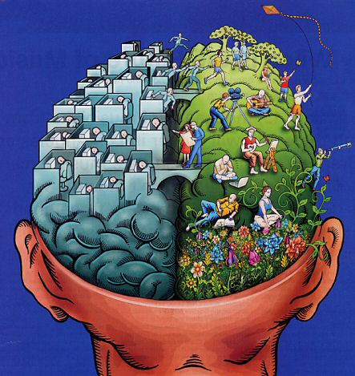
11.Dyscalculia is an inherited condition.

Slide 13
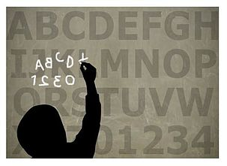
12. Most people with dyscalculia also have dyslexia.

