Slide 2
Session 1
Course Introduction

Slide 3
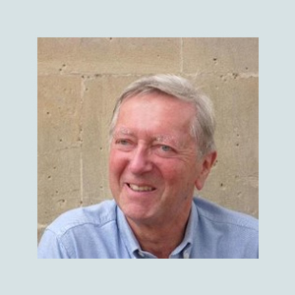
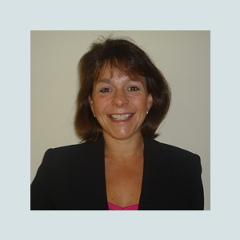
Course Leaders
Prof Steve Chinn
PhD FRSA AMBDA
stevechinn.co.uk
mathsexplained.co.uk
Judy Hornigold BSc PGCSpE FHEA AMBDA
judyhornigold.co.uk
judy@judyhornigold.co.uk

Slide 4
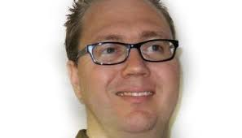
E-learning platform manager
Arran Smith

Slide 5
Welcome
Thank you for enrolling on this course.
Our aim for the course is to make it as personal and as practical as possible, enabling you to feel confident in identifying learners with maths difficulties and dyscalculia.
On successful completion of the Level 5 course, you will be an accredited specialist teacher in maths difficulties and dyscalculia.
Please note that this course does not enable you to diagnose dyscalculia unless you already have Level 7 or equivalent qualifications in diagnosing dyslexia.

Slide 6
Course Delivery
This is an online course.
Sessions will be recorded by either Judy or Steve and will be accessible at any time by course participants.
Tutor support will be available from Judy.
Every month there will be a live support session via Zoom.
Progress will be monitored and assessed via a series of practicum assignments.

Slide 7
Other course features
Guest speakers
Monthly prize draw
Online forum
Weekly discussion point
Newsletter

Slide 8
Course Objectives
Identify, assess and diagnose maths learning difficulties and dyscalculia
Know how to implement effective differentiation to lessons for SEN students
Understand why there is a need to set an appropriate classroom ethos and how this may be achieved
Set up a resource base to aid teaching students with maths difficulties

Slide 9
Session Overview – Part 1- 3 sessions
Session 1
Introduction to the course
Session 2 (presented by Judy)
Mathematical Learning Difficulties and dyscalculia.
The learning spectrum.
Definitions and descriptions.

Slide 10
Session Overview – Part 1- 3 sessions
Session 3 (presented by Judy)
Building understanding and empathy for learners.
Maths anxiety and the affective domain.
Self-esteem. Self-concept. Self-efficacy
Attributional style

Slide 11
Session Overview- Part 2- 7 sessions
Session 1 (presented by Judy)
The foundations. Developing number sense and operation sense. Place value.
Session2 (presented by Steve)
Strategies for accessing (and understanding) the basic addition and subtraction facts.

Slide 12
Session 3 (presented by Steve)
How maths develops. From the basics to algebra.
Fractions, decimals, percentages.
Session 4 (presented by Judy)
Singapore Maths
Session 5 ( presented by Judy)
Manipulatives.
Session 6 (presented by Judy)
Bar Modelling and Word Problems

Slide 13
Session 7 (presented by Steve)
Theories of learning.
Professor Sharma-components of a mathematical idea and six levels of learning.
Multiplication facts. Rote learning and alternative strategies. An introduction to developmental teaching.
'Long' multiplication and division, traditional and non-traditional methods.

Slide 14
Session Overview- Part 3 – 3 sessions
Part 3 (3 sessions) Level 5 only
Diagnosis and Assessment
Session1 (presented by Steve)
Setting up a test protocol:
1. Informal clinical diagnostic procedure.
2. Tests of basic facts.
3. A 15-minute standardised maths test. Standardised and criterion referenced tests.
4. A maths anxiety questionnaire
5. Short term memory. Working memory.
6. Cognitive style in maths.
7. A dyscalculia checklist

Slide 15
Session Overview- Part 3 – 3 sessions
Session 2 (presented by Steve )
Error patterns.
Session 3 (presented by Judy)
Lesson planning

Slide 16
Practicum for Level 5
A portfolio of teaching practice with reflective comments including teaching resources, materials and differentiated worksheets.
10 hours of evaluated specialist teaching
A minimum of one hour of teaching /learning support to be observed and assessed by the Dyscalculia Association
Completion of a series of practicum tasks

Slide 17
Practicum Activity 1
To be completed after studying all three sessions of Part 1 of the course.
Select one factor, such as poor short term memory or maths anxiety that has a negative influence on learning maths and describe three examples you have experienced of this with learners, what intervention(s) you tried and appraise the outcome.
(Suggested word count 500-1000 words)

Slide 18
Practicum Activity 2
To be completed after studying sessions 1 and 2 of Part 2 of the course.
Discuss the impact of poor retrieval of basic facts, including slow retrieval and inaccurate recall. Provide data on the extent of this issue for your students. If possible, explore this for a range of ages and explain the impact of these issues at different stages in learning maths.
(Suggested word count 500 – 1000 words)

Slide 19
Practicum Activity 3
To be completed after studying sessions 3 and 4 of Part 2 of the course.
Discuss the principles behind the Singapore approach and how they may support learners with maths difficulties or dyscalculia.
(Suggested word count 500 – 1000 words)

Slide 20
Practicum Activity 4
To be completed after studying session 7 of Part 2 of the course.
Discuss Mahesh Sharma’s three key components of mathematics and the six levels of knowing:
(Suggested word count 500 -1000 words)

Slide 21
Practicum Activity 5:Level 5 only
To be completed after studying Part 3 of the course
Explain how dyslexia, dyspraxia and ADHD can impact on the learning of maths and thus dyscalculia.
(Suggested word count 500 -1000 words)

Slide 22
Final Assignment Level 5 only
To be completed after studying all three parts of the course and after delivering 10 lessons.
1)Submission of 10 annotated and evaluated lesson plans.
(no maximum word count)
2)Essay:
(Suggested word count 2000 words)

Slide 23
Essay
The essay should be critical evaluation of and reflection on the lessons that you have delivered.
Covering the following:
The nature of dyscalculia and general maths difficulties, referencing this to current research where appropriate.
Why you chose the learner that you have worked with and what difficulties in Maths they are displaying.
The rationale behind your intervention and lesson structure/content.
Reflection on how successful you feel the intervention has been. Is there anything that you would have changed - what worked well and what didn’t work?
How has the course impacted on your teaching practice and what will be your next steps on terms of working with learners with maths difficulties and dyscalculia.

Slide 24
Before you go on to Session 2……
Dyscalculia: True or False?
Try our myth busting Quiz.

